Slide 1
Course Info
CS103 Discrete Structure
Introduction and Motivation
Taken from Imdad Ullah Khan
Course Info

Slide 2
Course Goals
Main Goals of CS-210 are to learn
basic principles of discrete mathematics their applications in computer science
fundamental discrete structures in computer science problem-solving skills
to synthesize elementary proofs counting techniques
to model computational problems by discrete structures such as graphs and trees
Course Info

Slide 3
How to succeed in this course
Read
Read lecture notes and slides
Handouts of slides will be uploaded after each lecture Read relevant sections in the textbook
The Universe is a grand book which cannot be read until one first learns to comprehend the language and become familiar with the characters in which it is composed. It is written in the language of mathematics. . .
Galilei Galileo
Course Info

Slide 4
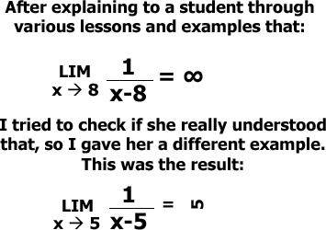
Wrong Reading
Muhammad Shahzad (GU TECH)
Course Info
Course Info
4 / 71

Slide 5
Wrong Reading
source: Google images
Muhammad Shahzad (GU TECH)
Course Info
Course Info

Slide 6
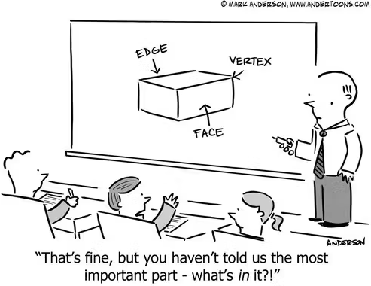
How to succeed in this course
Discuss
Discuss lecture material with your peers Remember homeworks are free to discuss
Discuss homework problems and book exercises with your peers
Ask questions during lectures and office hours
In mathematics the art of proposing a question must be held of higher value than solving it.
George Cantor
Muhammad Shahzad (GU TECH)
Course Info
Course Info

Slide 7
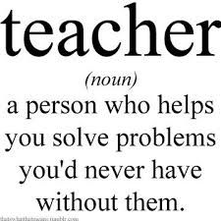
How to succeed in this course
Practice
Try as many textbook examples and exercises Solve all homework problems
Don’t panic if you are stuck
credit: https://prleap.com/
I don’t have any magical ability...I look at the problem, and it looks like one I’ve already done. When nothing’s working out, then I think of a small trick that makes it a little better. I play with the problem, and after a while, I figure out what’s going on.
Terry Tao
Muhammad Shahzad (GU TECH)
Course Info
Course Info

Slide 8
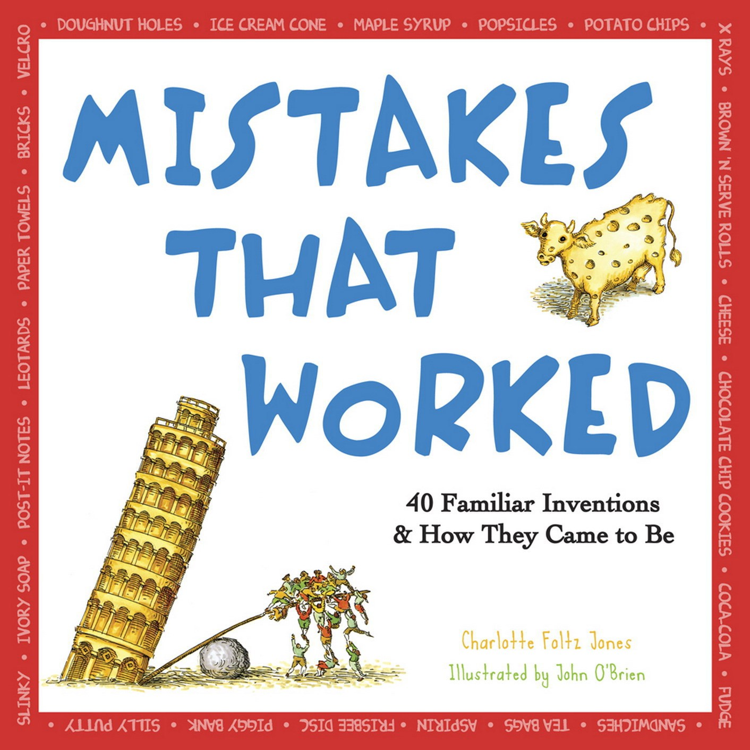
How to succeed in this course
Make Mistakes
Do not worry if you cannot get a problem right in first attempt
You learn the most from mistakes
Do not worry about your difficulties in Mathematics. I can assure you mine are still greater.
Albert Einstein
Muhammad Shahzad (GU TECH)
Course Info
Course Info
8 / 71

Slide 9
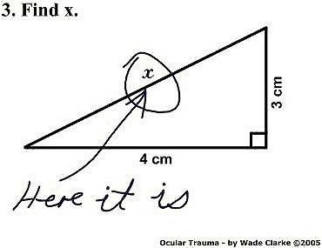
Wrong Solution
You think this solution is wrong? See the following.
Muhammad Shahzad (GU TECH)
Course Info
Course Info
9 / 71

Slide 10
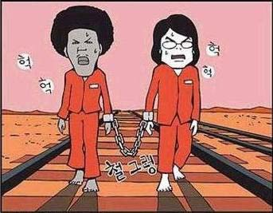
Wrong Solution
Muhammad Shahzad (GU TECH)
Course Info
Muhammad Shahzad (GU TECH)
Course Info
Muhammad Shahzad (GU TECH)
Course Info
10 / 71
Course Info

Slide 11
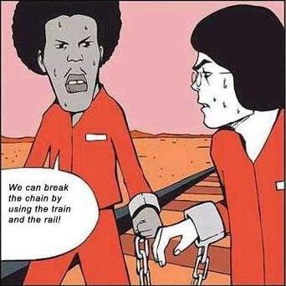
Wrong Solution
Muhammad Shahzad (GU TECH)
Course Info
Course Info
11 / 71

Slide 12
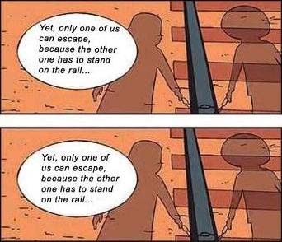
Wrong Solution
Muhammad Shahzad (GU TECH)
Course Info

Slide 13
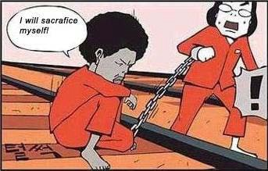
Wrong Solution
Muhammad Shahzad (GU TECH)
Course Info

Slide 14
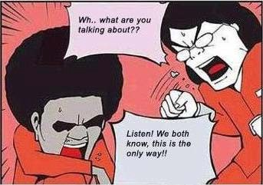
Wrong Solution
Muhammad Shahzad (GU TECH)
Course Info

Slide 15
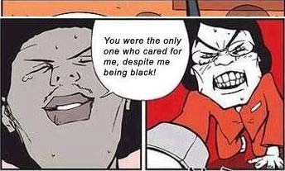
Wrong Solution
Muhammad Shahzad (GU TECH)
Course Info

Slide 16
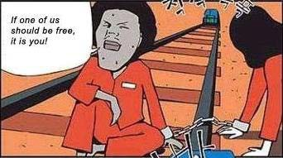
Wrong Solution
Muhammad Shahzad (GU TECH)
Course Info

Slide 17
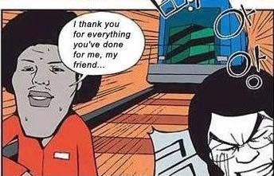
Wrong Solution
Muhammad Shahzad (GU TECH)
Course Info

Slide 18
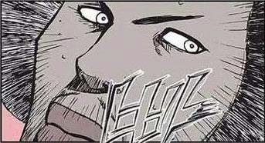
Wrong Solution
Muhammad Shahzad (GU TECH)
Course Info

Slide 19
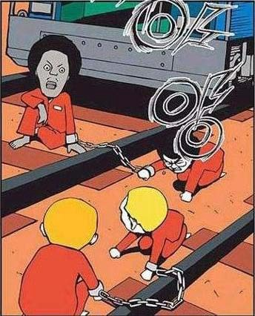
Wrong Solution
Muhammad Shahzad (GU TECH)
Course Info

Slide 20
Wrong Solution: Moral of the Story
THE SOLUTION IS ALWAYS SIMPLE ONCE YOU KNOW IT.
Source: Prof. Nabil Mustafa course
Muhammad Shahzad (GU TECH)
Course Info

Slide 21
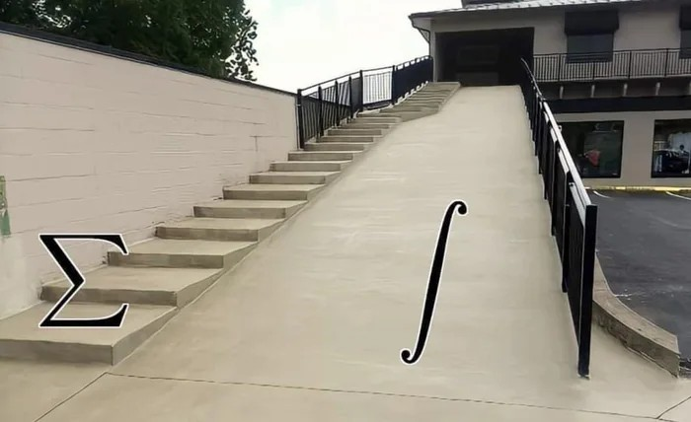
Why Study Discrete Math?
Discrete Mathematics is the study of discrete (not continuous) objects
▷ Unlike Calculus (no limits, continuity, differentiation)
source: Google images
Muhammad Shahzad (GU TECH)
Course Info

Slide 22
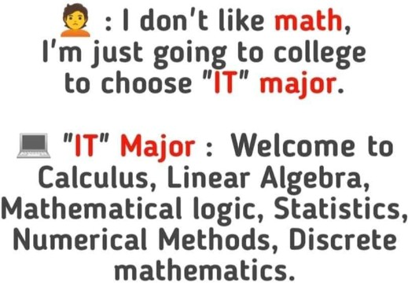
Why Study Discrete Math?
Computer Science = Problem Solving
Mathematics is at the heart of problem solving
definition, modeling, solution, analysis
Computers are discrete objects operating one discontinuous (discrete) step at a time
Discrete mathematics is the right framework for describing precisely CS concepts
source: ProgrammerHumor.io
Computer Science is no more about computers than astronomy is about telescopes.
Edsger Dijkstra
Muhammad Shahzad (GU TECH)
Course Info

Slide 23
Why Study Discrete Math?
Conceptual core of computer science is Algorithm
Discrete Mathematics helps provide
techniques to design algorithms
methods to prove the correctness of algorithms tools to analyze algorithms
Muhammad Shahzad (GU TECH)
Course Info

Slide 24
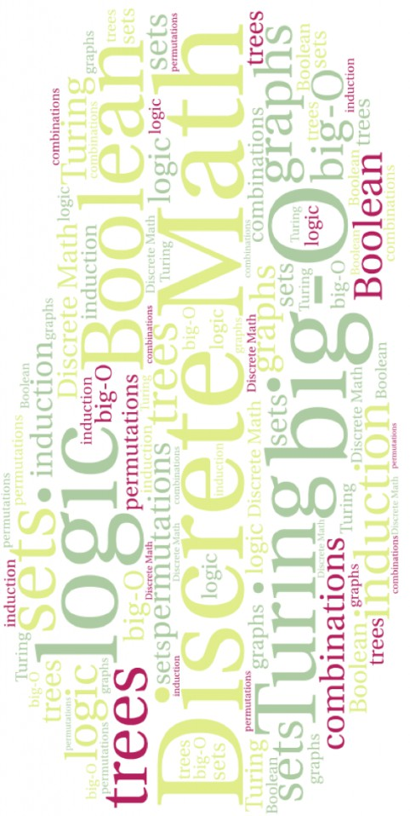
Why Study Discrete Math? Topics
source: Colorado State University | Topic | Sections in Rosen 6Ed
 | Logic | 1.1 - 1.4
 | Sets | 2.1 - 2.2
 | Functions | 2.3 - 2.4
 | Sequence and Sums | 2.4
 | Relations & Partial Orders | Ch. 8
 | Proofs | 1.5 - 1.7
 | Induction | Ch. 4
 | Basic Counting | 5.1 - 5.3
 | Advanced Counting | 5.4, 5.5, 7.5
 | Recursion and Recurrences | 7.1- 7.3
 | Graphs | Ch. 9
 | Trees | 10.1 - 10.2, 10.4 - 10.5
 | Number Theory & Cryptography | 3.4 - 3.7
Muhammad Shahzad (GU TECH)
Course Info

Slide 25
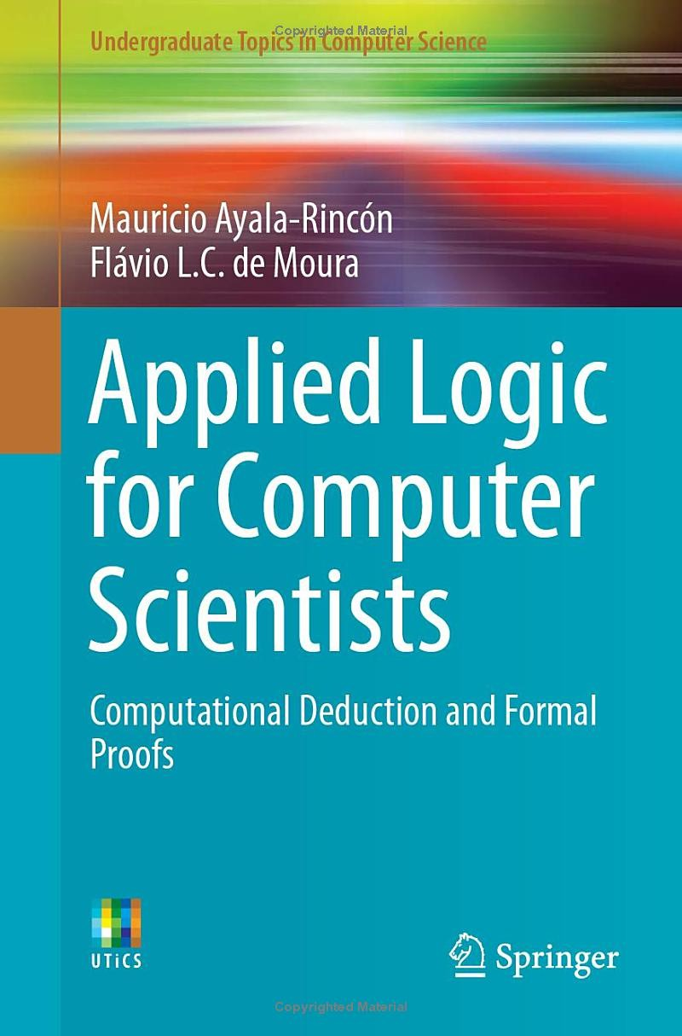
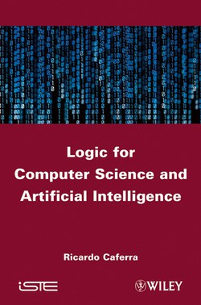
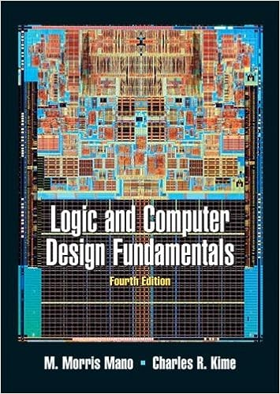
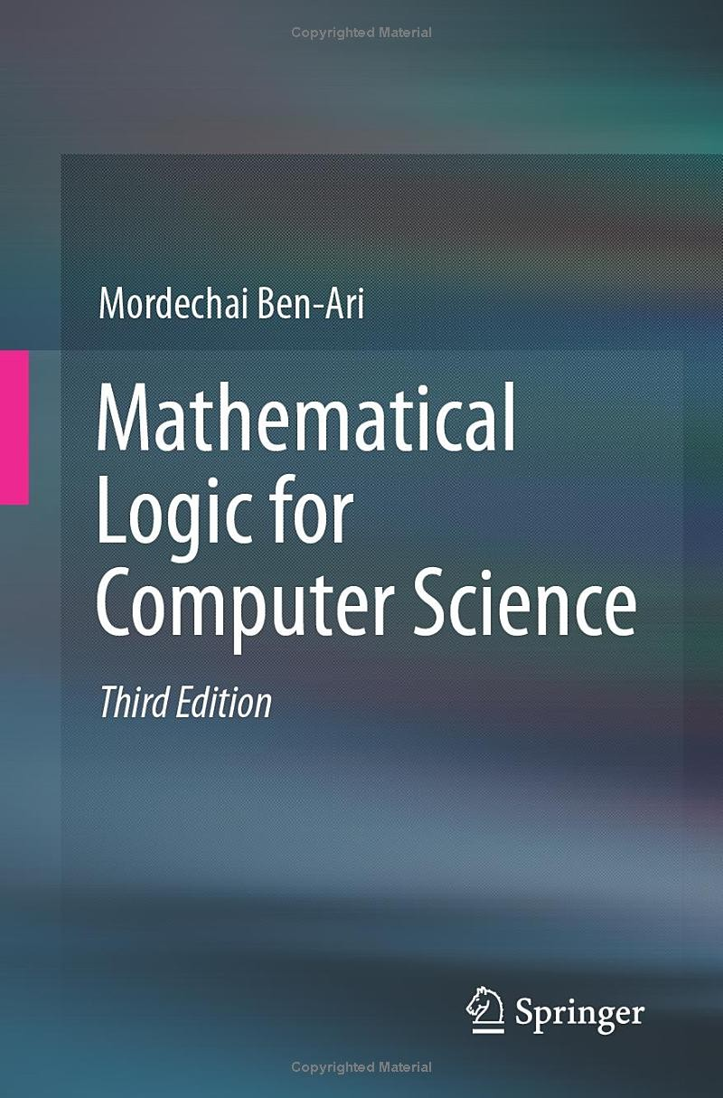
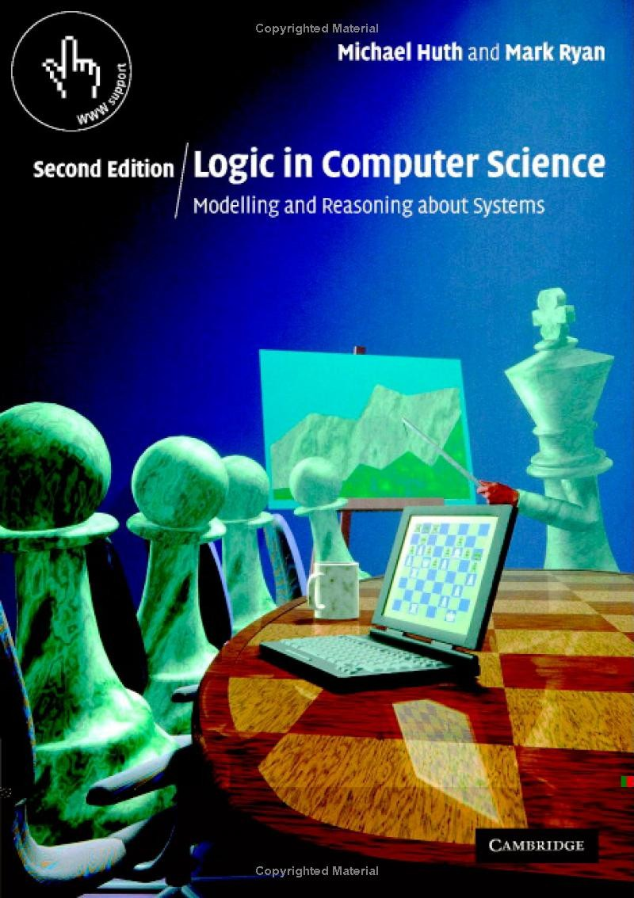

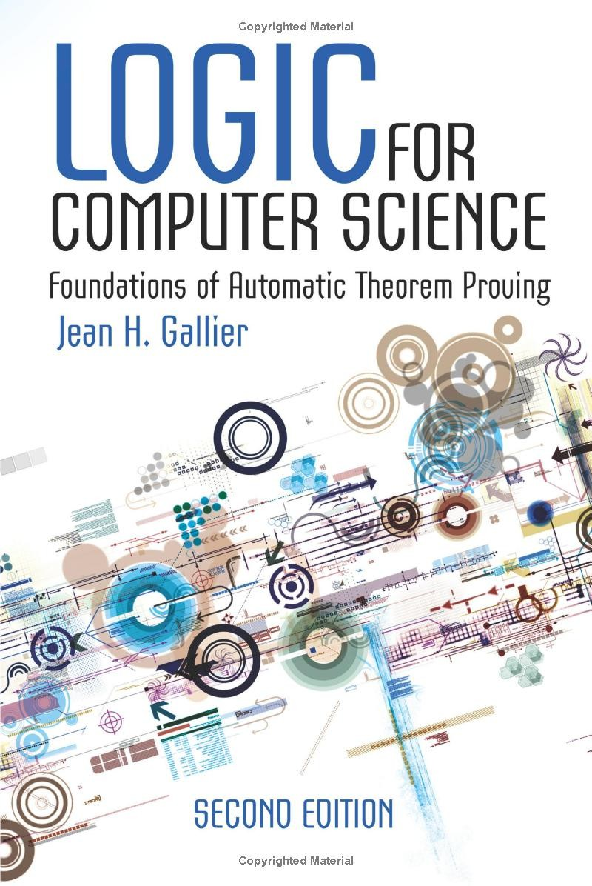
Why Study Discrete Math? Topics
Logic:
Fundamental to all mathematical disciplines
Logic is the study of the principles and methods that distinguishes between a valid and an invalid argument.
Useful for hardware design, computer architecture
Artificial Intelligence, Natural Language Processing, Knowledge Representation
Muhammad Shahzad (GU TECH)
Course Info

Slide 26
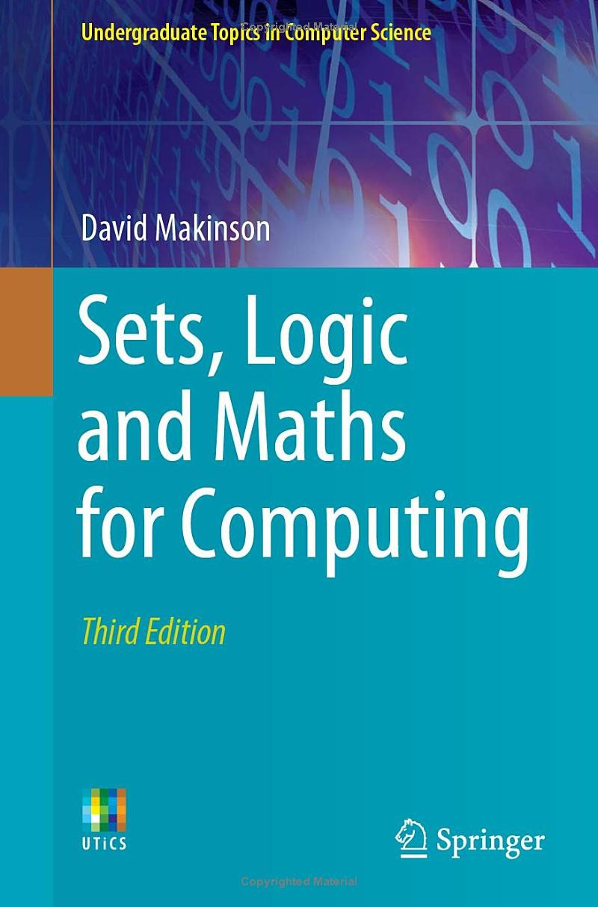

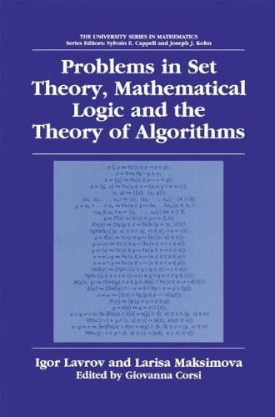
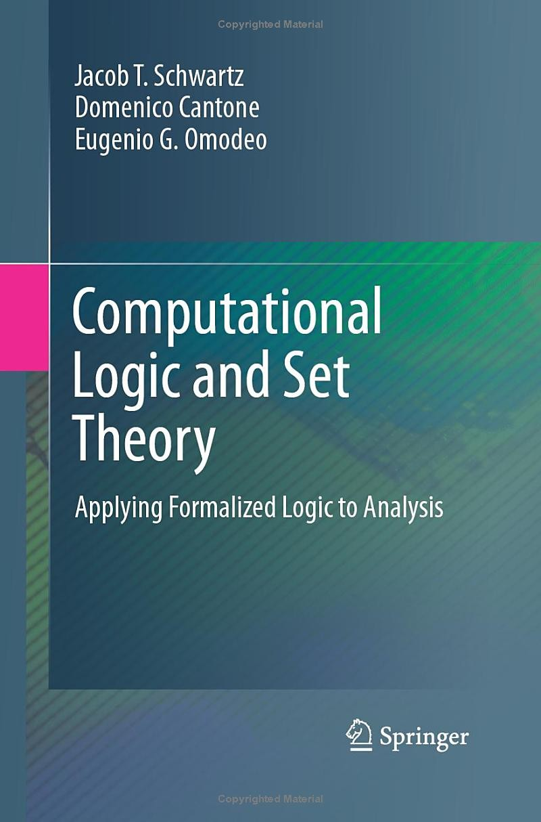
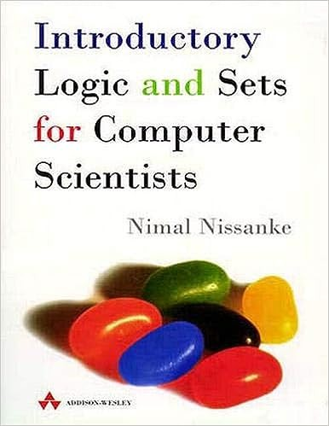

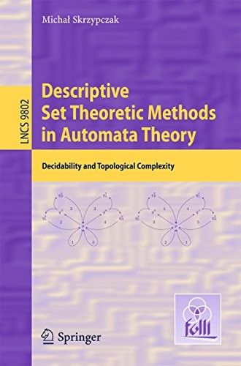
Why Study Discrete Math? Topics
Sets:
Fundamental to all mathematical disciplines
Provide foundations for various CS disciplines, especially
Data Structures Algorithms Probability Database
Muhammad Shahzad (GU TECH)
Course Info

Slide 27
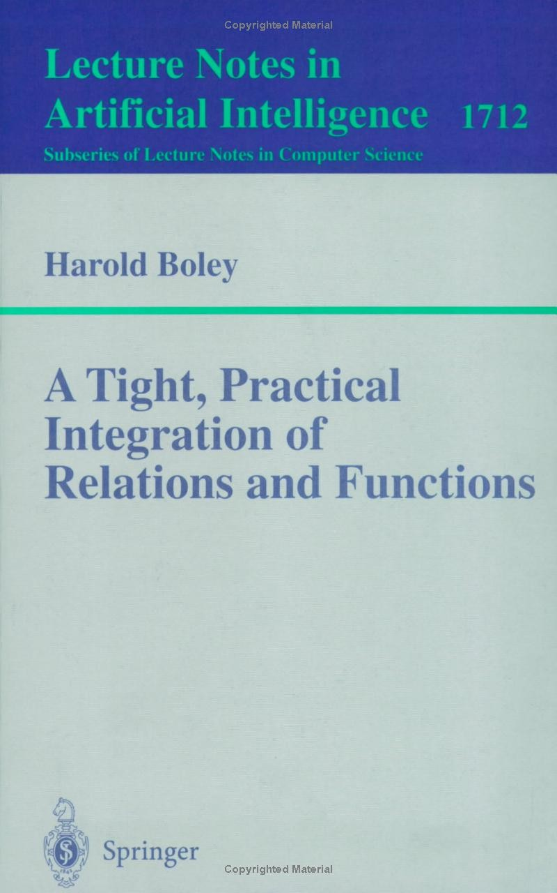
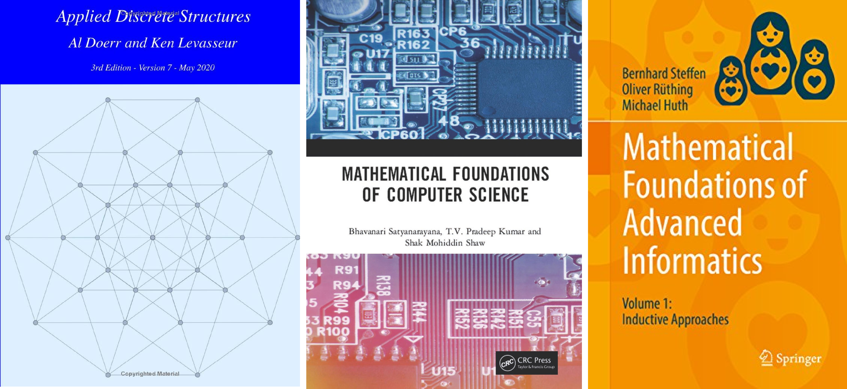
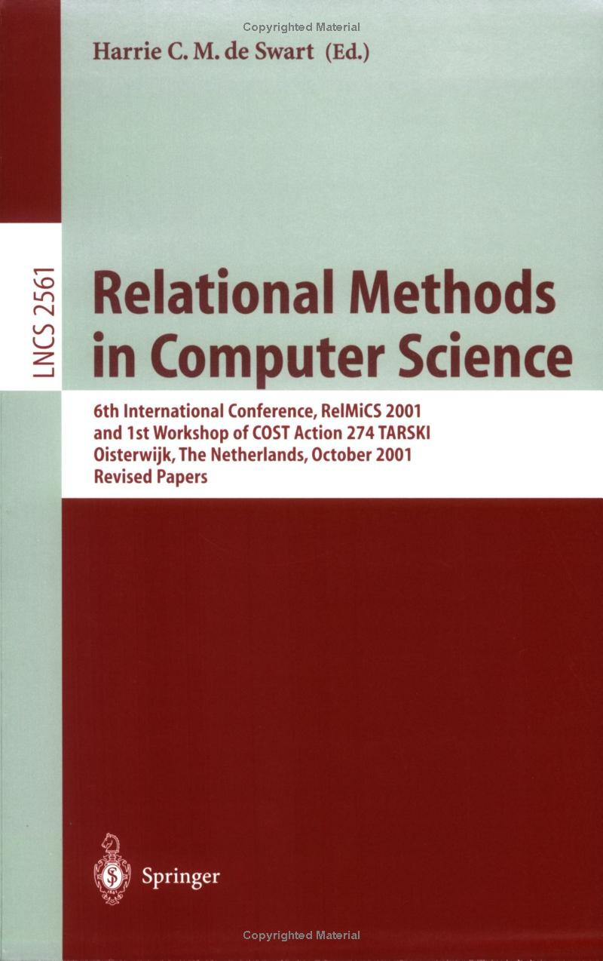
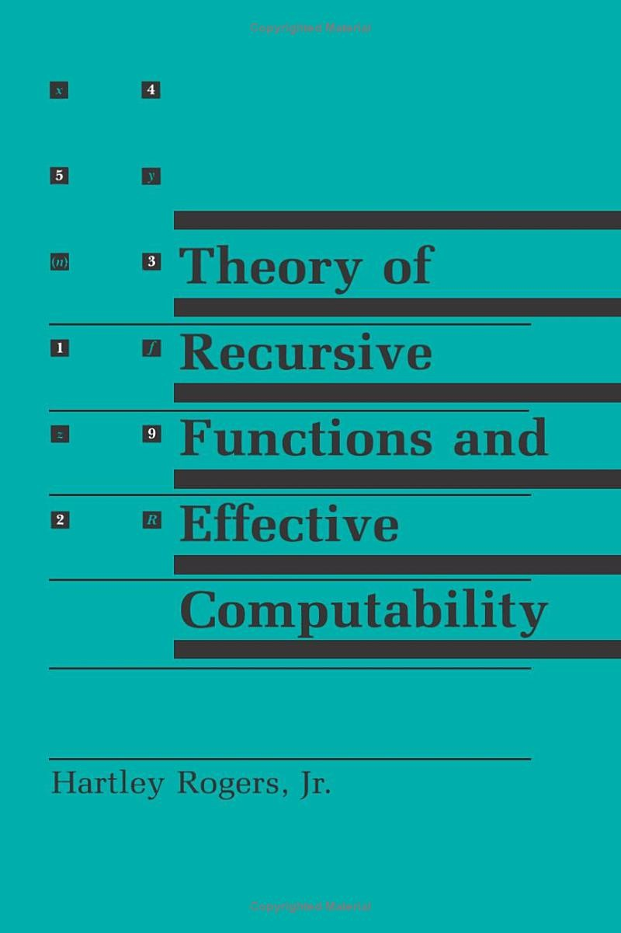
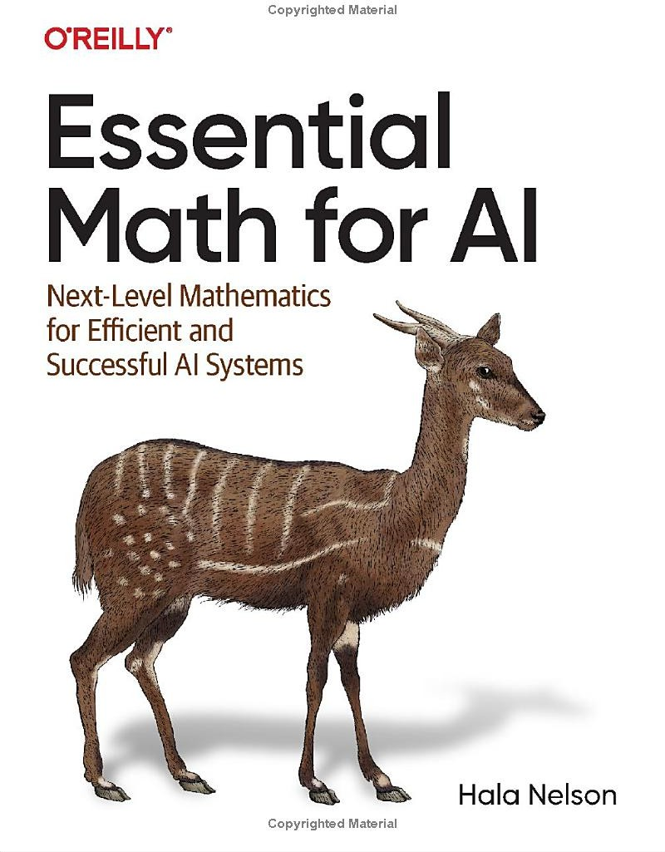
Why Study Discrete Math? Topics
Functions, Relations, Recurrences:
Building blocks for
Hashing Cryptography
Programming Languages Database systems
Recursive Algorithm Analysis
Muhammad Shahzad (GU TECH)
Course Info

Slide 28
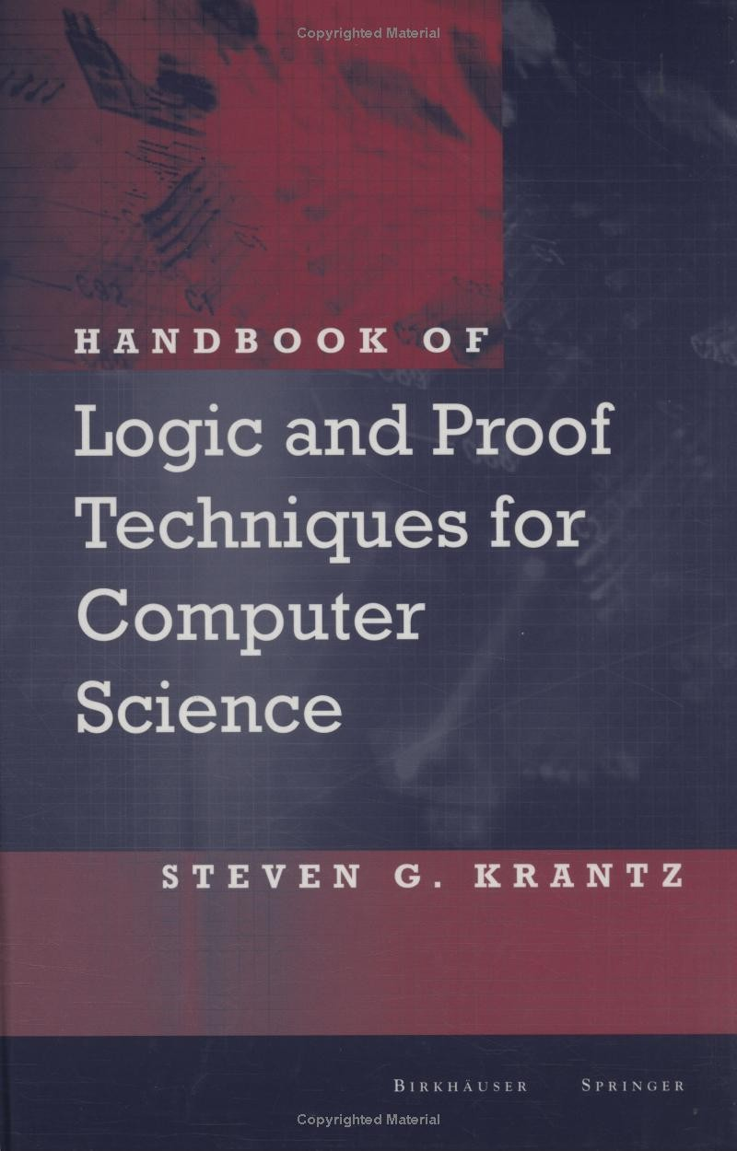
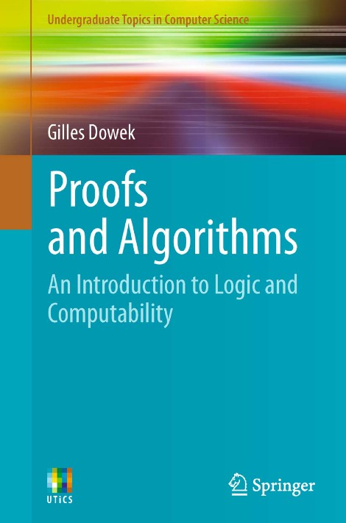
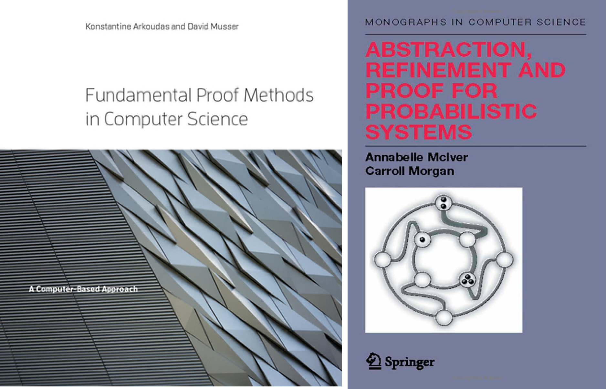
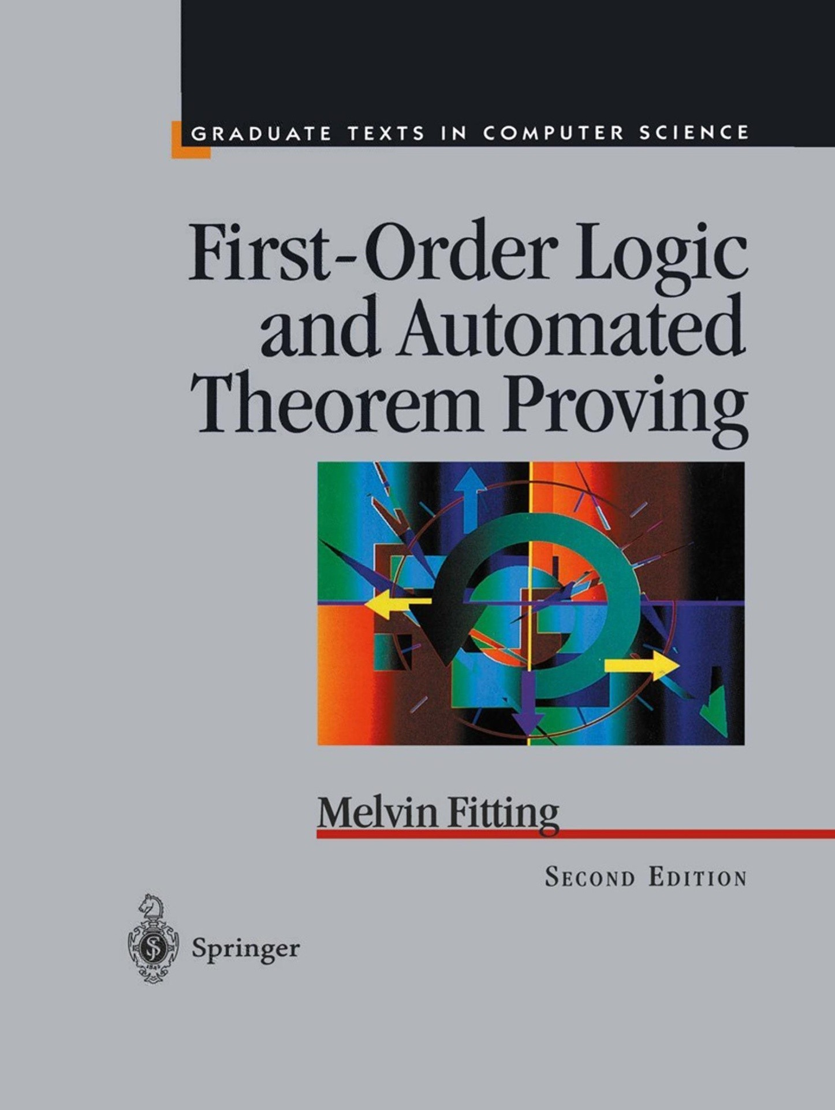
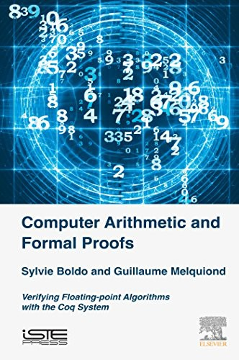
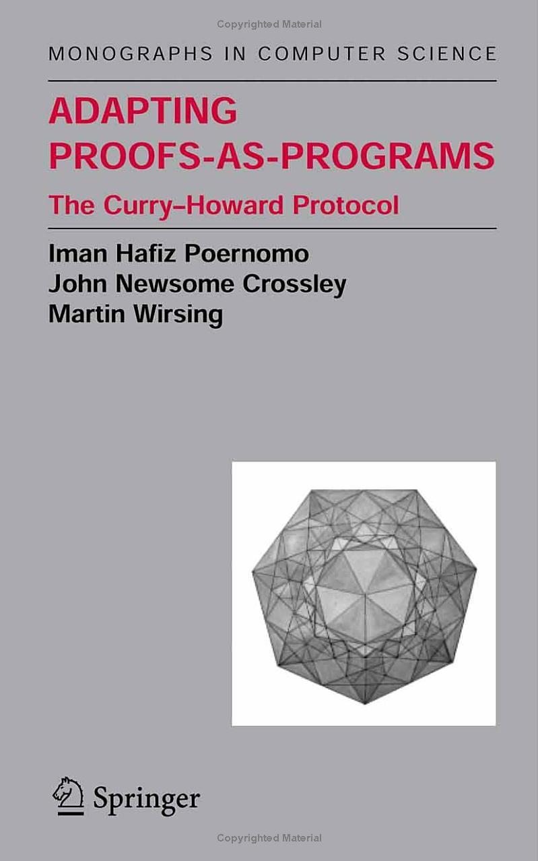
Why Study Discrete Math? Topics
Proofs:
A mathematician is a device for turning coffee into theorems
Alfr´ed R´enyi
Prove that your program has no bug Verify that the hardware is correct
Muhammad Shahzad (GU TECH)
Course Info

Slide 29
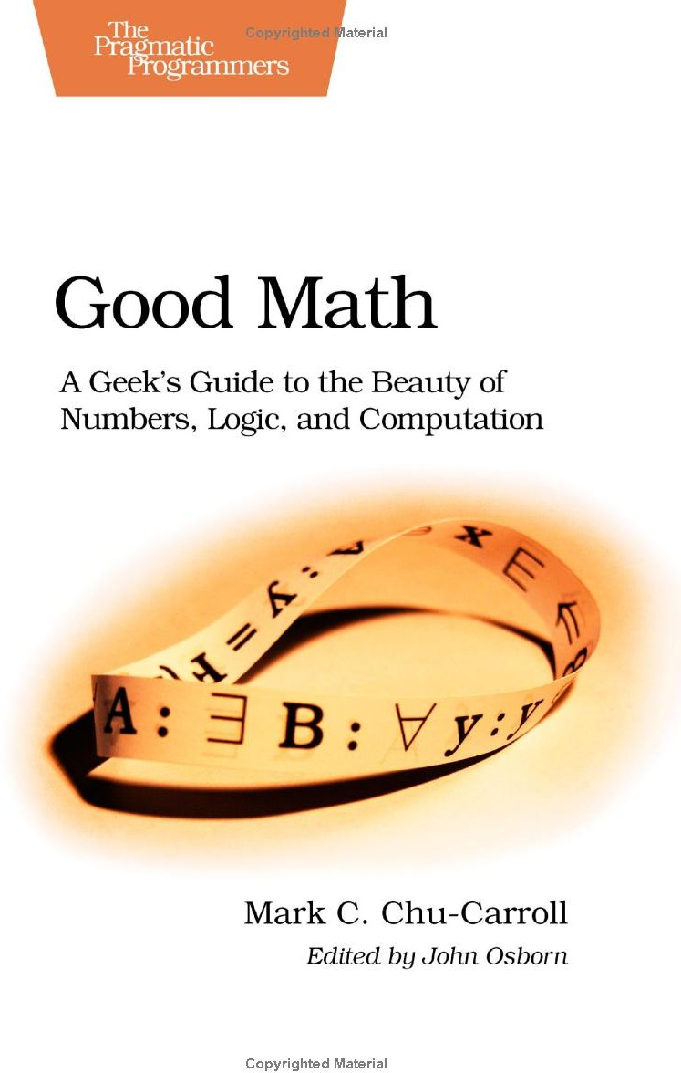
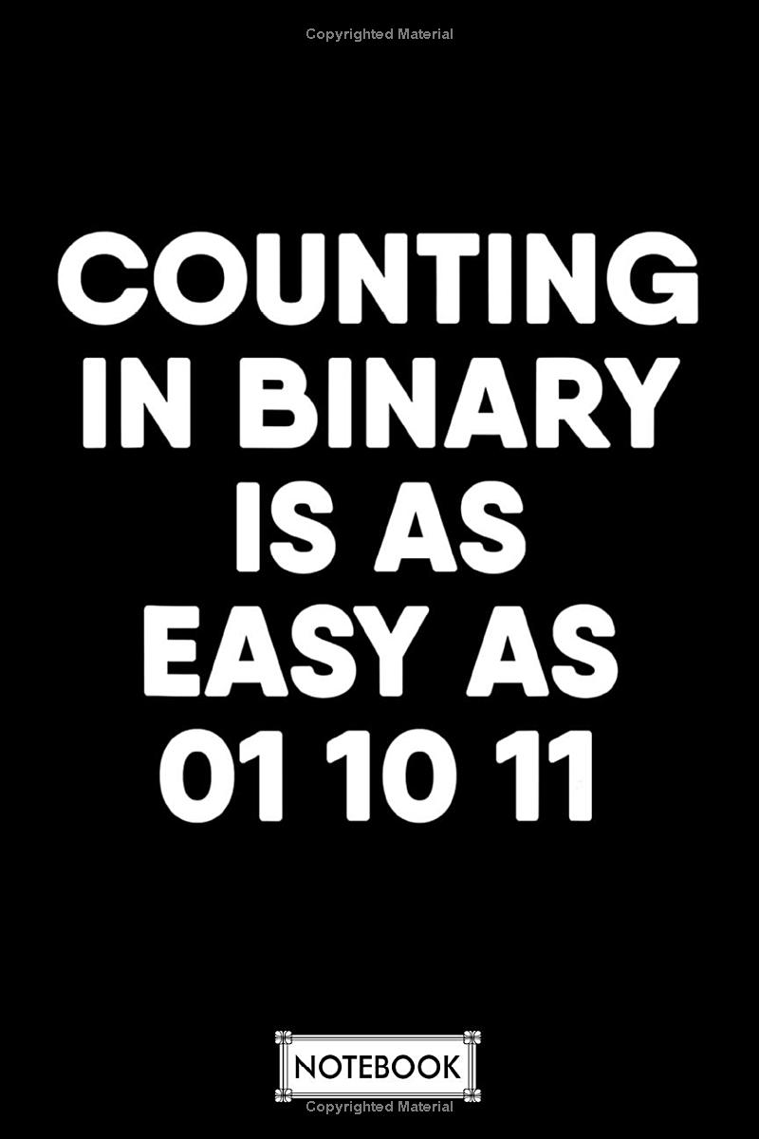
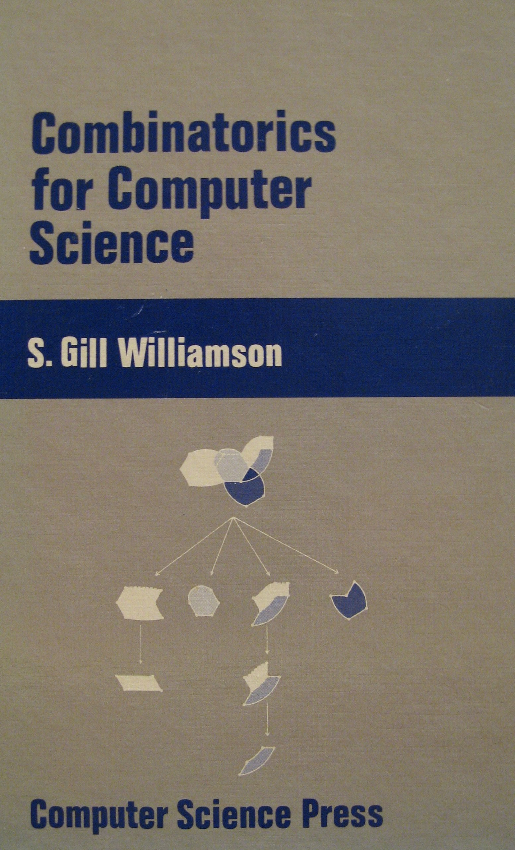
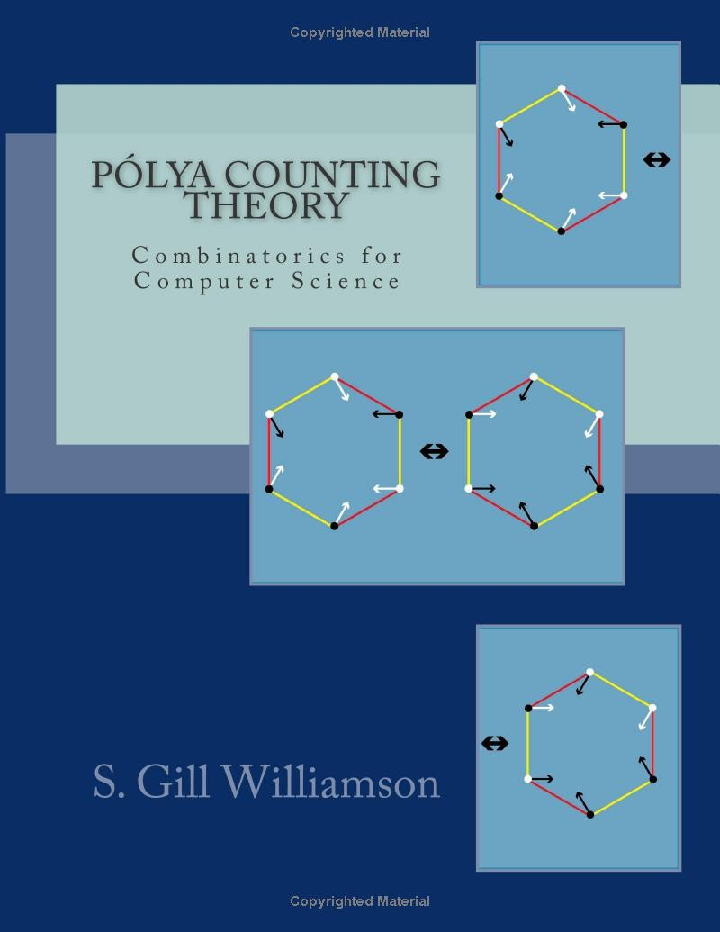
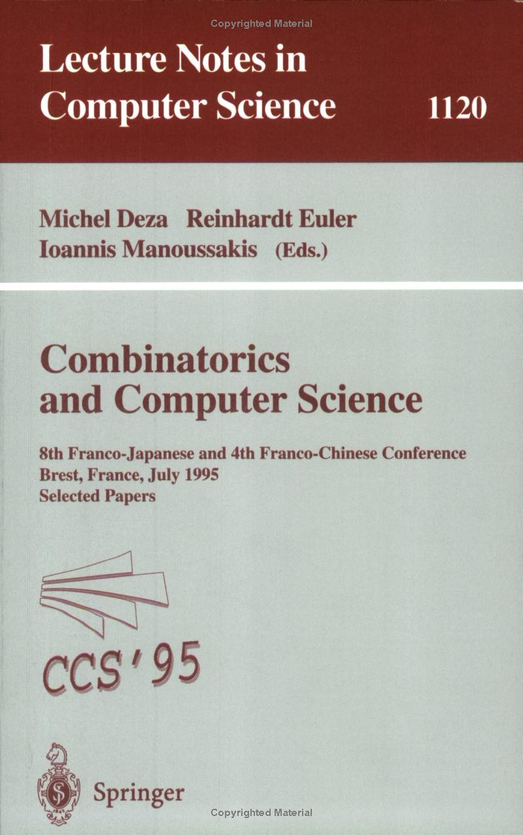
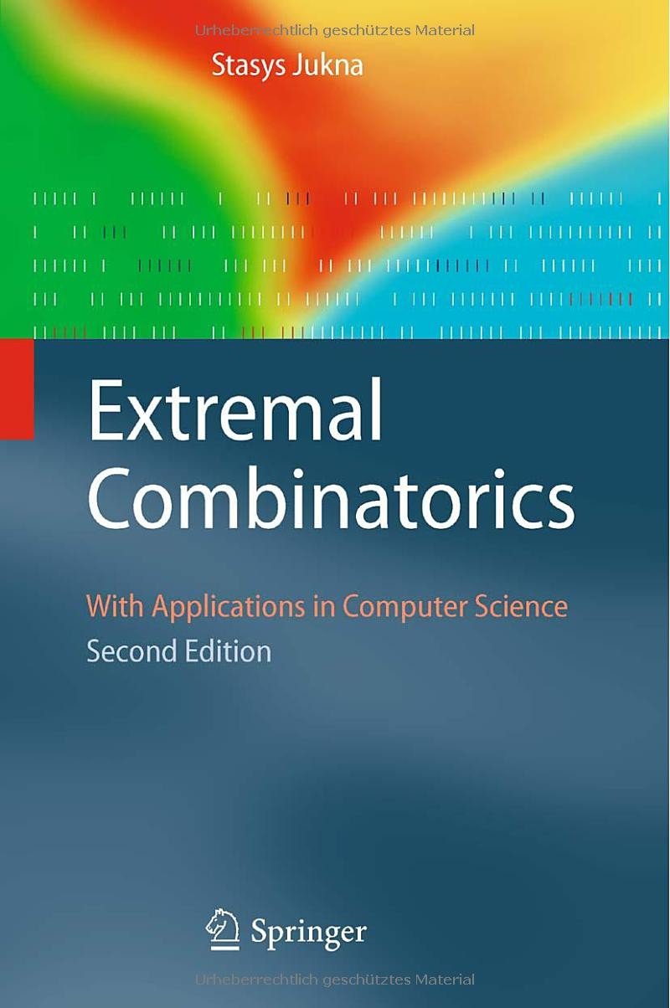
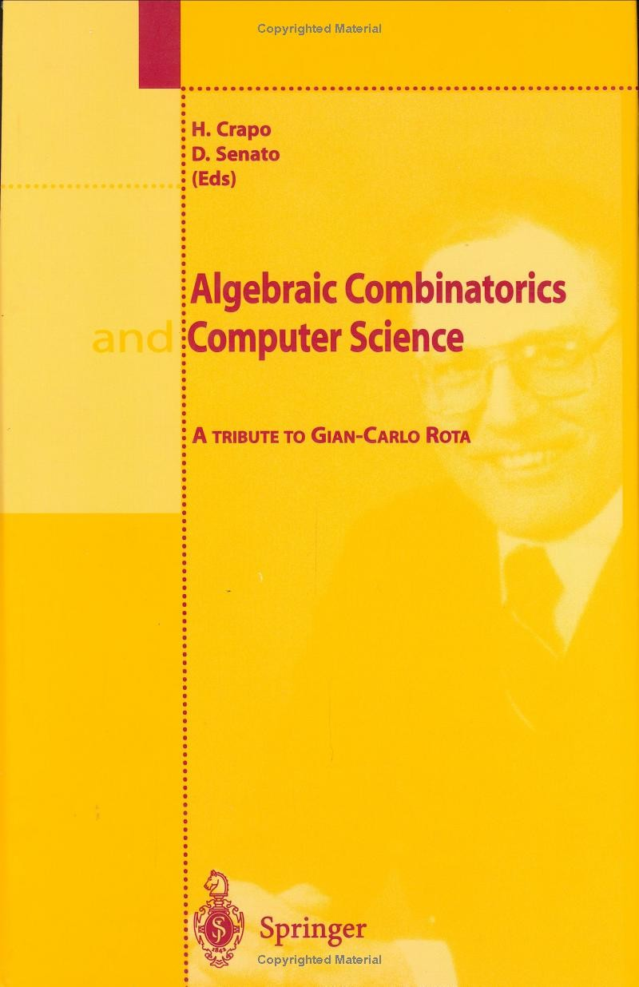
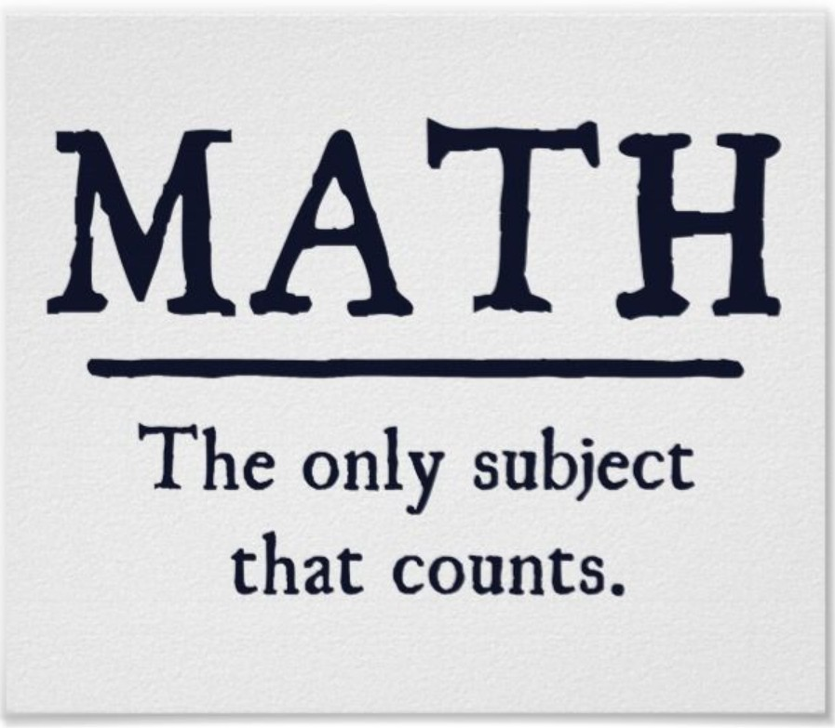
Why Study Discrete Math? Topics
Counting and Combinatorics:
The lottery is a tax on people who flunked math
Monique Lloyd
Calculate your chances of a component failure Analyze how long a program takes to finish Very useful in designing algorithms
credit: https://zazzle.com/
Muhammad Shahzad (GU TECH)
Course Info

Slide 30
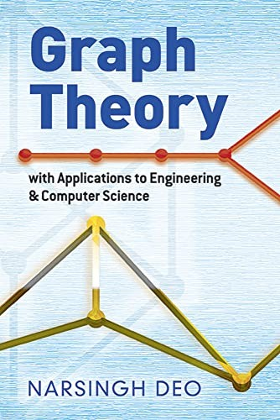
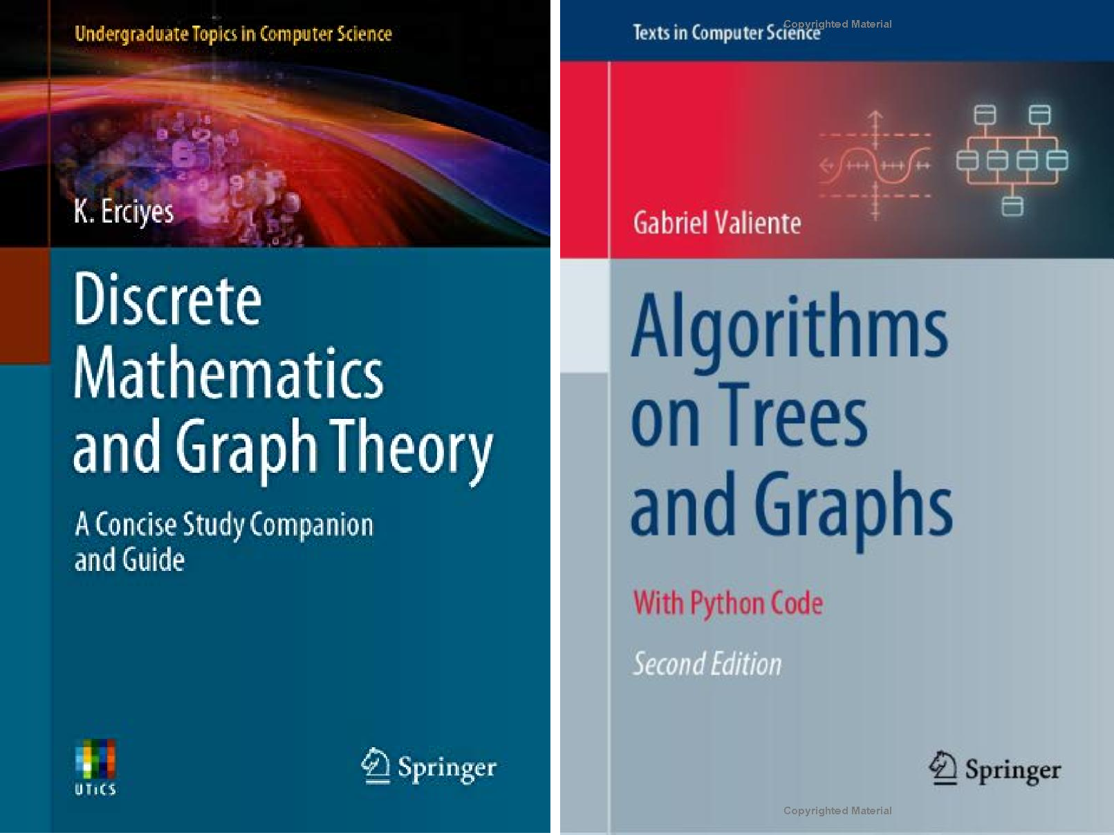


Why Study Discrete Math? Topics
Graph Theory:
Provide techniques for many clever data-structures for organizing information
Many problems are modeled and efficiently solved using graphs particularly problems in Networks, Operating systems, Database
Muhammad Shahzad (GU TECH)
Course Info

Slide 31

Applications: Logic
In a certain island there are two types of people
source: Matthew Sgambati, UMD
Knights always tell the truth Knaves always lie
Muhammad Shahzad (GU TECH)
Course Info

Slide 32
Applications: Logic
A says: “Both of us are knights”
B says: “A is a knave”
Suppose A is a knight. What A says is true
B is a knight. What B says is true
A is a knave
Result: A is knave, B is knight
▷ IMPOSSIBLE
Muhammad Shahzad (GU TECH)
Course Info

Slide 33
Applications: Logic
A says, “I am a knave or B is a knight”
B says nothing
Result: Both are knights
Muhammad Shahzad (GU TECH)
Course Info

Slide 34

Applications: Doctor Who’s Question
source: Google images
In Doctor Who story Pyramids of Mars (a British TV show in the 70’s), he had to choose between two doors.
One door → death and the other → freedom.
There were two robots, A and B, one guarding each door, one Knight and one Knave. He has only one Yes/No question to ask, to determine the door to freedom.
Muhammad Shahzad (GU TECH)
Course Info

Slide 35
Applications: Doctor Who’s Question
Ask robot A
“Will robot B tell me that your door leads to freedom?”
Muhammad Shahzad (GU TECH)
Course Info

Slide 36

Applications: Proofs
Theorem (?)
Muhammad Shahzad (GU TECH)
Course Info

Slide 37

Muhammad Shahzad (GU TECH)
Course Info

Slide 38
Applications: Counting
When Friedrich Gauss was nine years old, their teacher wanted to pass time so asked the class to evaluate
1 + 2 + 3 + · · · · · · + 998 + 999 + 1000
Gauss solved the problem in 30 seconds.
It seems a lot of stuff is attributed to Gauss – either he was really smart or he had a great press agent.
Sidenote in ‘Concrete Mathematics’
Muhammad Shahzad (GU TECH)
Course Info

Slide 39
Applications: Counting
8 | 9 | 3 | 4 | 2
2 | 3 | 4 | 8 | 9
Selection Sort
for i = 1 to n − 1 for j = i + 1 to n
if (A[i ] > A[j])
exchange A[i ] and A[j]
How many times is the comparison made?
Muhammad Shahzad (GU TECH)
Course Info

Slide 40

Applications: Counting
Organizing Tournaments
n teams are participating in Round 1 of a soccer tournament
Every team play every other team exactly once
Each game is refereed by a professional, charging $1 per game
What is the total payment to the referee?
A round-robin tournament with 10 teams (Wikipedia)
Muhammad Shahzad (GU TECH)
Course Info

Slide 41
Applications: Counting
Answer to all 3 questions is the same (Week 9)
Muhammad Shahzad (GU TECH)
Course Info

Slide 42





Applications: Counting
How many watermelons are in each group?
5 × 5
4 × 4
3 × 3
2 × 2
1 × 1
Muhammad Shahzad (GU TECH)
Course Info

Slide 43

Applications: Counting
How many watermelons in this square base pyramid ?
₁2
+ ₂2
+ ₃2
+ ₄2
+ ₅2
+ ₆2
+
.
Muhammad Shahzad (GU TECH)
Course Info

Slide 44
Applications: Counting
How many passwords can be made from the characters
{a, b, f , g, h, l , m, o, t, u}
Length of password is 10 but no repetition
No password contain the word ‘gulf’, ‘math’ or ’boat’.
How many rooms are needed to schedule 300 exams in one week?
08:00AM
10:00AM
10:00AM
12:00PM
12:00PM
02:00PM
02:00PM
04:00AM
04:00PM
06:00AM
06:00PM
08:00PM
No two simultaneous exams in a room
6 time slots per day in the exam week (7 days)
Muhammad Shahzad (GU TECH)
Course Info

Slide 45

Write a small piece of code to draw this pattern in color
Applications: Counting
Muhammad Shahzad (GU TECH)
Course Info

Slide 46
Applications: Recurrences
The Josephus Problem: Matter of Life and Death
During the Jewish-Roman war, Falvius Josephus was among 41 soldiers trapped in a cave. They preferred suicide over capture and formed a circle. Going around the circle, they killed every third remaining person until no one was left. But Josephus and another person survived.
He was lucky!
No, he knew Discrete Mathematics
Muhammad Shahzad (GU TECH)
Course Info

Slide 47
Applications: Recurrences
The Josephus Problem (a variant)
10 People numbered 1 to 10, n = 10
Every other person is killed starting with number 2. Which person survives? What is J(10)?
Muhammad Shahzad (GU TECH)
Course Info

Slide 48

Applications: Recurrences
Muhammad Shahzad (GU TECH)
Course Info

Slide 49

Applications: Recurrences
Muhammad Shahzad (GU TECH)
Course Info

Slide 50

Applications: Recurrences
Muhammad Shahzad (GU TECH)
Course Info

Slide 51

Applications: Recurrences
Muhammad Shahzad (GU TECH)
Course Info

Slide 52

Applications: Recurrences
Muhammad Shahzad (GU TECH)
Course Info

Slide 53

Applications: Recurrences
Muhammad Shahzad (GU TECH)
Course Info

Slide 54

Applications: Recurrences
Muhammad Shahzad (GU TECH)
Course Info

Slide 55

Applications: Recurrences
Muhammad Shahzad (GU TECH)
Course Info

Slide 56

Applications: Recurrences
Muhammad Shahzad (GU TECH)
Course Info

Slide 57

Applications: Recurrences
Muhammad Shahzad (GU TECH)
Course Info

Slide 58

Applications: Recurrences
Muhammad Shahzad (GU TECH)
Course Info

Slide 59
Applications: Recurrences
J(10) = 5
Muhammad Shahzad (GU TECH)
Course Info

Slide 60

Applications: Recurrences
Muhammad Shahzad (GU TECH)
Course Info

Slide 61
Applications: Recurrences
n | J(n)
1 | 1
2 | 1
3 | 3
4 | 1
5 | 3
6 | 5
7 | 7
8 | 1
9 | 3
10 | 5
11 | 7
Muhammad Shahzad (GU TECH)
Course Info

Slide 62
Applications: Recurrences
Josesphus knew Discrete Mathematics, Recurrence (Week 8)
J(1) = 1
J(2n) = 2J(n) − 1,
J(2n + 1) = 2J(n) + 1,
for n ≥ 1
for n ≥ 1
J(2^{m} + ℓ) = 2ℓ + 1,
m
for m ≥ 0 and 0 ≤ ℓ < 2
Muhammad Shahzad (GU TECH)
Course Info

Slide 63

Applications: Graphs
Draw the picture without lifting pencil or retracing
Tour the building/place passing each door/building exactly once
Muhammad Shahzad (GU TECH)
Course Info

Slide 64





Applications: Graphs
Ferryman wants to transport all 3 objects to the other side, but Boat can carry one object with ferryman
Wolf cannot be alone with goat Goat cannot be alone with cabbage
Muhammad Shahzad (GU TECH)
Course Info

Slide 65



Applications: Graphs
A salesman wants to visit all cities with minimum cost Optimize the tool path for manufacturing equipment
credit: study.com
Muhammad Shahzad (GU TECH)
Course Info

Slide 66





Applications: Private Key Cryptography
Alice sends message to Bob, Eve eavesdrops
message x
x
message x
Alice
Bob
Eve
Eavesdropper
Exchange the encryption key for a good cipher!
key
key
message x
y
message x
Encrypt
Decrypt
Alice
Bob
Eve
Eavesdropper
But during key exchange, Eve could get the key and all security is lost!
Muhammad Shahzad (GU TECH)
Course Info

Slide 67
Applications: Public Key Cryptography
Alice sends message to Bob, Eve eavesdrops
message x
x
message x
Alice
Bob
Eve
Eavesdropper
Everyone knows public key, only Bob knows private key
Bob’s public key
Bob’s private key
message x
y
message x
Encrypt
Decrypt
Bob’s public key
Alice
Bob
Eve
Eavesdropper
Alice encrypts with public key, Bob decrypts with private key
Eve cannot do anything! ▷ No key exchange
Muhammad Shahzad (GU TECH)
Course Info

Slide 68

Why Study Discrete Mathematics (Textbook backcover)
Muhammad Shahzad (GU TECH)
Course Info

